Slide 1
Research Project -Students’ Income and Expense
Gayun Lee, Taewoo Kim, Sung Mo Koo, Javier Rodríguez Caballero Lopez, Philipp Merrouche

Slide 2



Slide 3

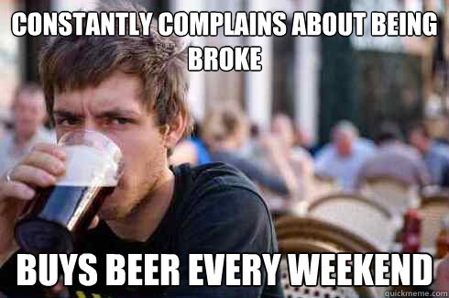
Background

Slide 4

Research Questions
Can any trend be identified with students’ income and expense?
How does expense of International students and that of Korean students compare?
Are there also any reasonable deviations between male and female students?

Slide 5
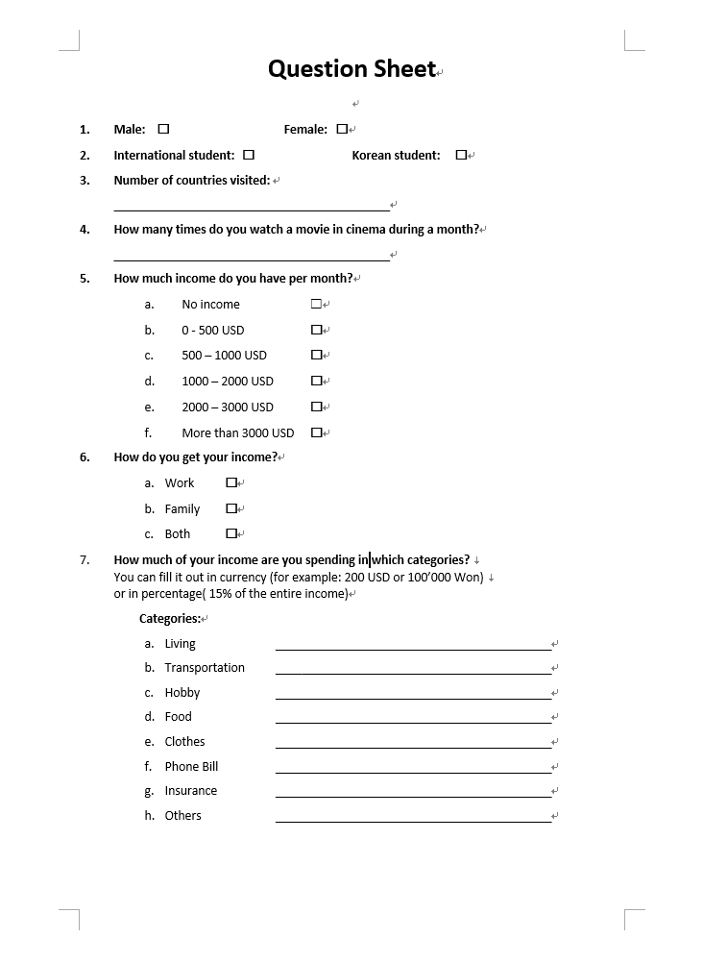
Method -Survey
Male/Female
International/domestic
Number of countries visited
Number of movies watched per month
Monthly income
Source of income
Expense categories

Slide 6
Raw Data
Survey Results
/Users/JRC2307/Desktop/SurveyResult.xlsx

Slide 7
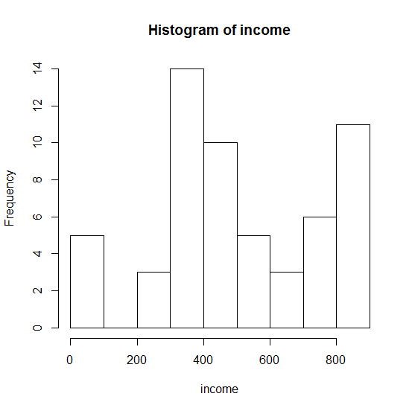
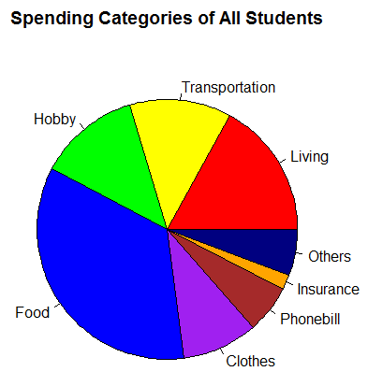
Results

Slide 8

Interpretation
Men
Women
Most spent
Countires traveled

Slide 9
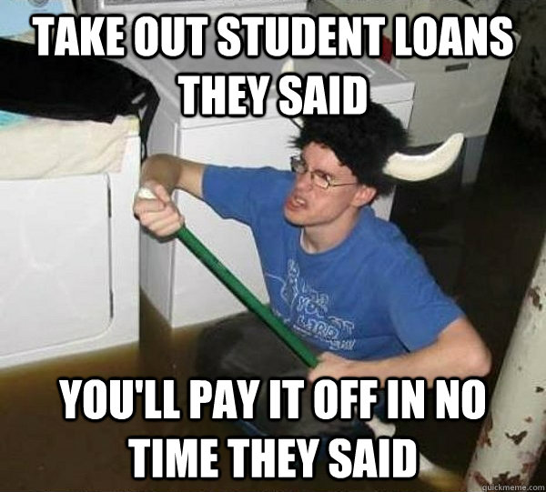

Conclusion

